Slide 1
Memory Interfacing
Notes:
See chapter Nine of Text book.

Slide 2
Memory Basics
Memory is generally divided into locations that store a fixed amount of data. (usually a byte)
For the entire memory to be useable, the processor should be capable of generating a unique address for each location.

Slide 3
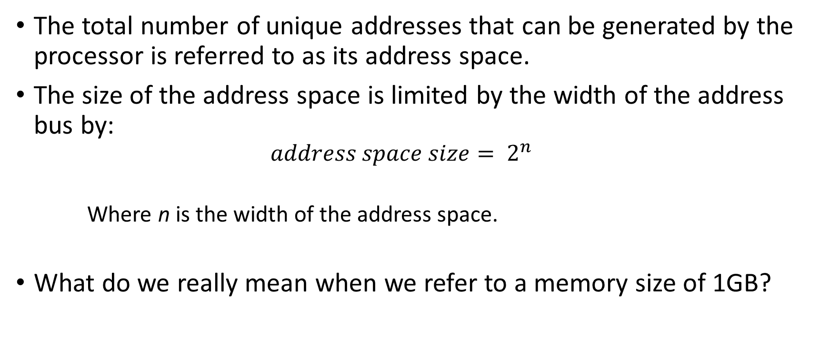
The total number of unique addresses that can be generated by the processor is referred to as its address space.
The size of the address space is limited by the width of the address bus by:
$$address space size= 2^{n}$$
Where n is the width of the address space.
What do we really mean when we refer to a memory size of 1GB?

Slide 4
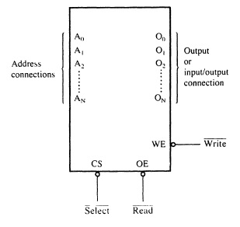
Memory connections

Slide 5
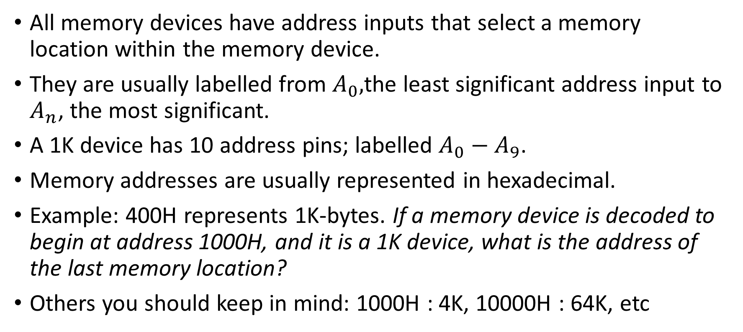
Address Connections
All memory devices have address inputs that select a memory location within the memory device.
They are usually labelled from $A_{0},$the least significant address input to $A_{n}$, the most significant.
A 1K device has 10 address pins; labelled $A_{0}−A_{9}$.
Memory addresses are usually represented in hexadecimal.
Example: 400H represents 1K-bytes. If a memory device is decoded to begin at address 1000H, and it is a 1K device, what is the address of the last memory location?
Others you should keep in mind: 1000H : 4K, 10000H : 64K, etc

Slide 6
Practical Application
Processors have a limit on how much memory they can make use of based on the address space.

Slide 7
Memory can be organized in different ways:
64 x 1 bit
8 x 1 byte
or
8 x 8 bit
16 x 4 bit
capacity of all these is 64 bits

Slide 8
Data Connections
All memory devices have a set of data outputs or input/outputs. The figure in slide 4 has a set of common I/O pins.
The data connections are the points at which data is entered for writing or extracted for reading.
Data pins on memory devices are almost always labelled Do – D7 for an 8-bit wide memory device. (Often called byte-wide memory)
It is however possible to have 16-bits, 4-bits, or just 1-bit wide memory devices.

Slide 9
Catalogue listings of memory devices often refer to memory locations times bits per location.
Example: 1K x 8, 16k x 1, etc.
Memory devices are also classified according to the total bit capacity.
Example: 1K x 8 may be listed as 8K, 64K x 4 as 256K, etc
Variations occur across manufacturers.

Slide 10
Test your understanding!
Why is the data bus bi-directional?
If a 32 bit microprocessor system is designed to access a memory system of total of 256 K bytes what is the data bus and the address bus lengths of the system.

Slide 11
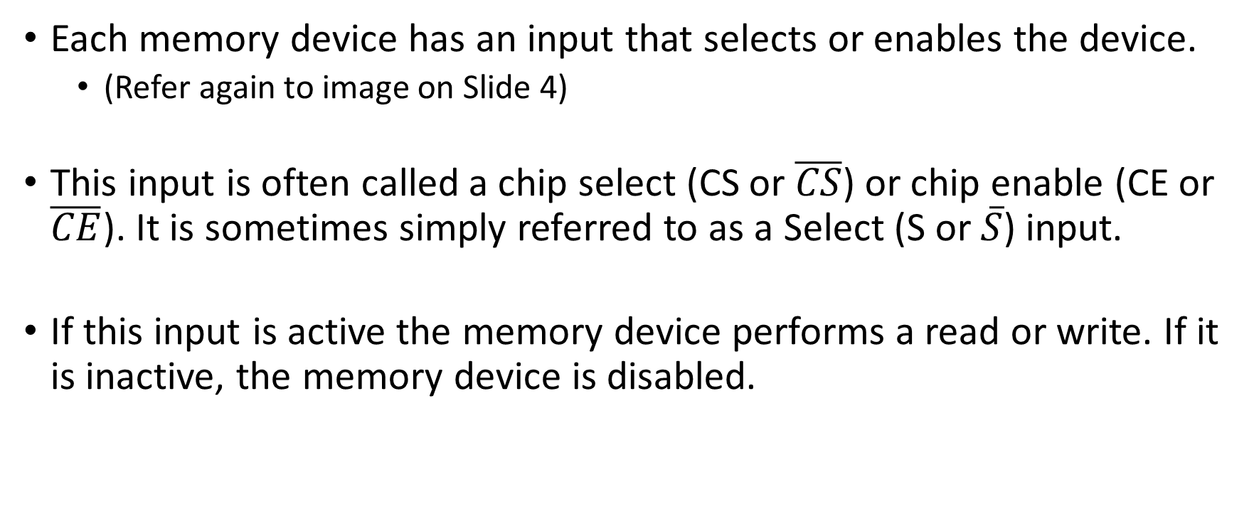
Selection Connections
Each memory device has an input that selects or enables the device.
(Refer again to image on Slide 4)
This input is often called a chip select (CS or $\overline{CS}$) or chip enable (CE or $\overline{CE}$). It is sometimes simply referred to as a Select (S or $\overline{S}$) input.
If this input is active the memory device performs a read or write. If it is inactive, the memory device is disabled.

Slide 12
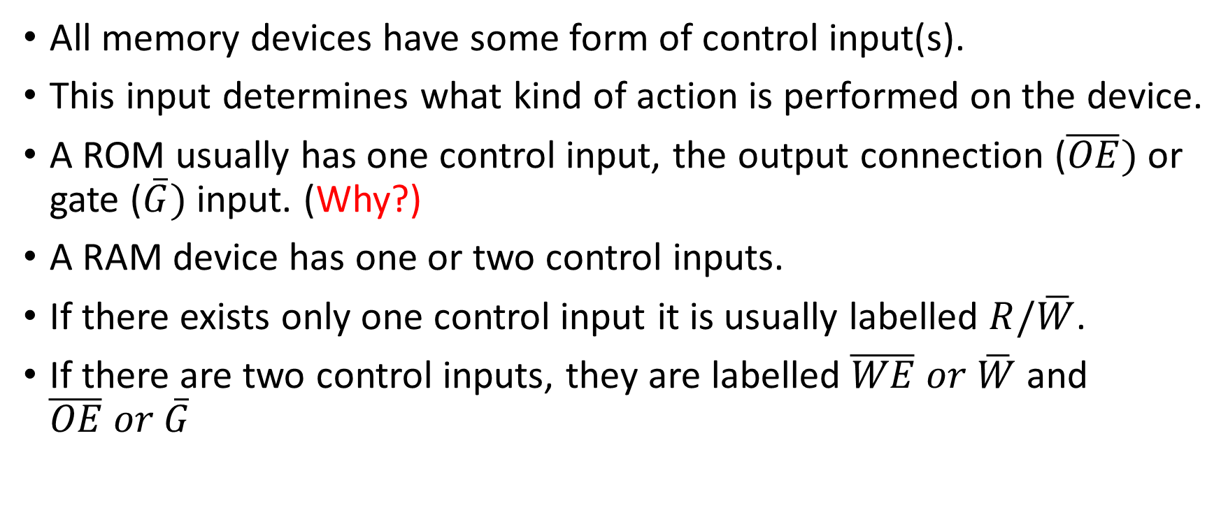
Control Connections
All memory devices have some form of control input(s).
This input determines what kind of action is performed on the device.
A ROM usually has one control input, the output connection ($\overline{OE})$ or gate ($\overline{G})$ input. (Why?)
A RAM device has one or two control inputs.
If there exists only one control input it is usually labelled $R/\overline{W}$.
If there are two control inputs, they are labelled $\overline{WE} or \overline{W}$ and $\overline{OE} or \overline{G}$

Slide 13
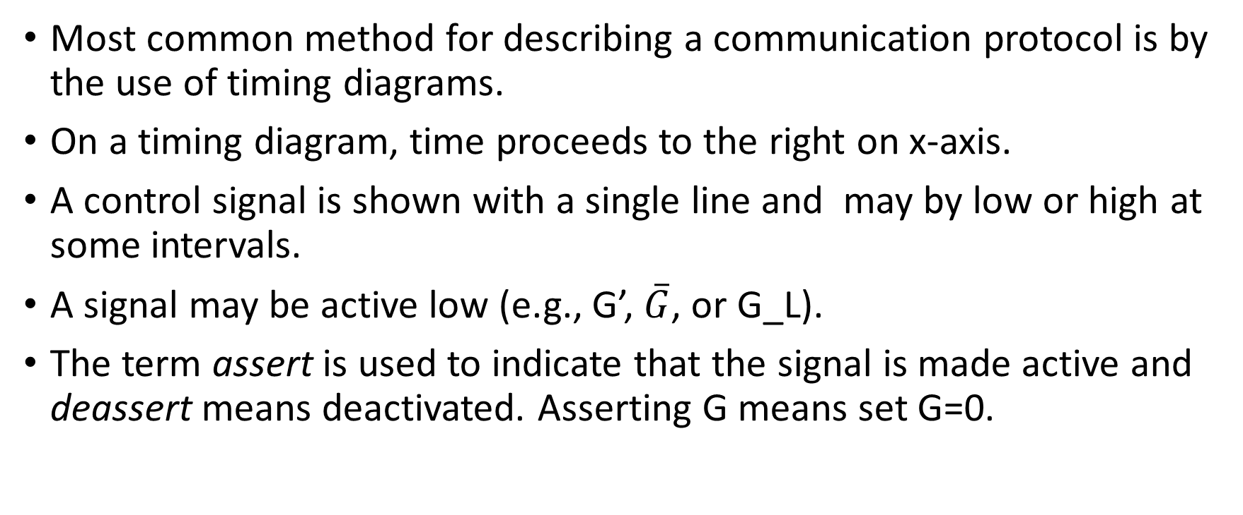
Read and Write Protocols Timing Diagrams
Most common method for describing a communication protocol is by the use of timing diagrams.
On a timing diagram, time proceeds to the right on x-axis.
A control signal is shown with a single line and may by low or high at some intervals.
A signal may be active low (e.g., G’, $\overline{G}$, or G_L).
The term assert is used to indicate that the signal is made active and deassert means deactivated. Asserting G means set G=0.

Slide 14


Deassert for an active low signal:
Data signals on the other hand are usually represented by a single line when inactive and a ‘double’ line when active.

Slide 15
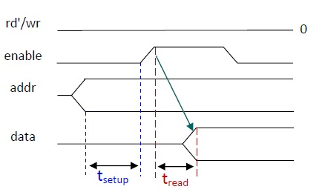
Read Protocol

Slide 16
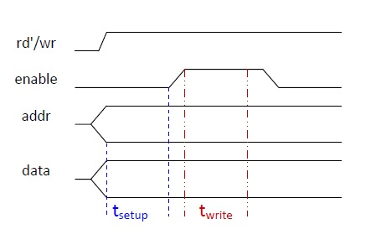
Write Protocol

Slide 17
Test Your Understanding…
Can you explain the difference between these three terms:
Setup time, read time, write time?

Slide 18
Assignment.
Read about different types of memory systems in use in today’s industry.
ROM, RAM, Disk, Cache, etc.

